Slide 1

Upload of MED&BS and FDI data
2nd Training
Excelsior Hotel, Bari (Italy), 20th-24th January 2025
W. Zupa, I. Bitetto

Slide 2
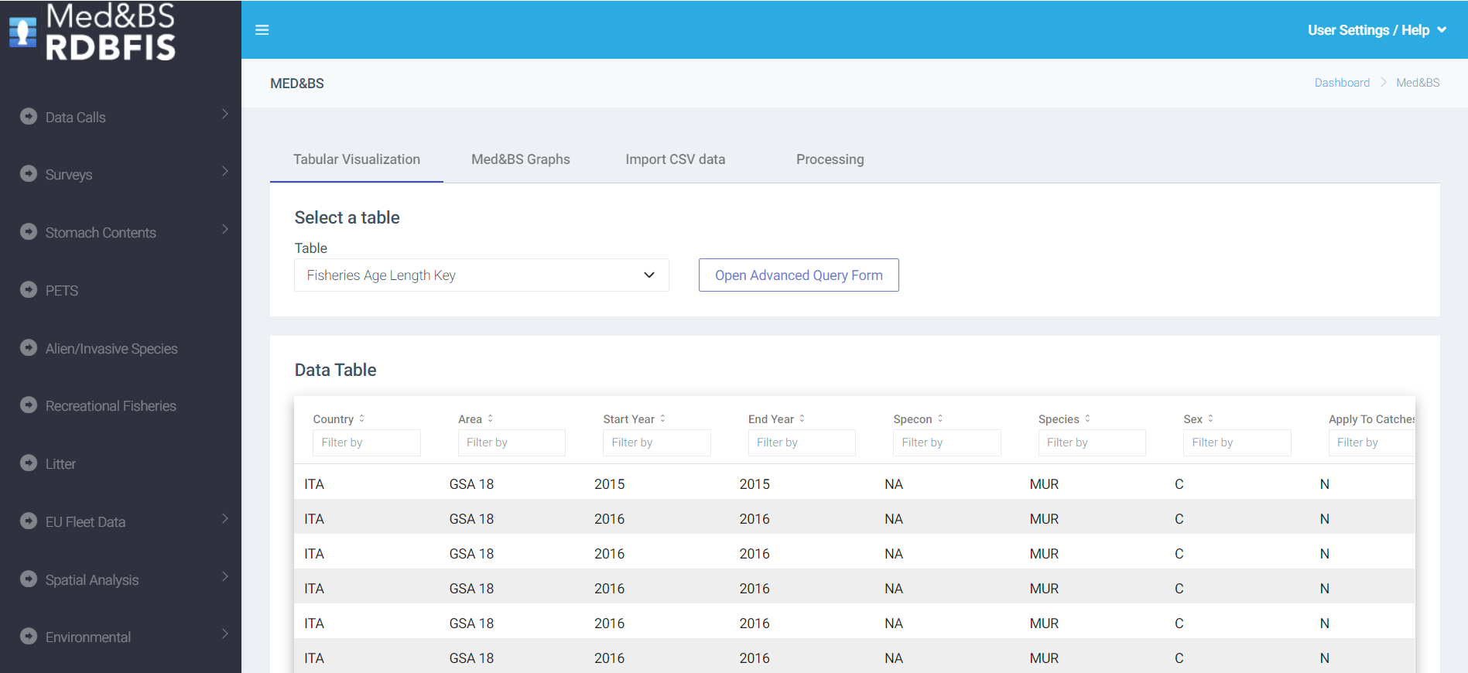
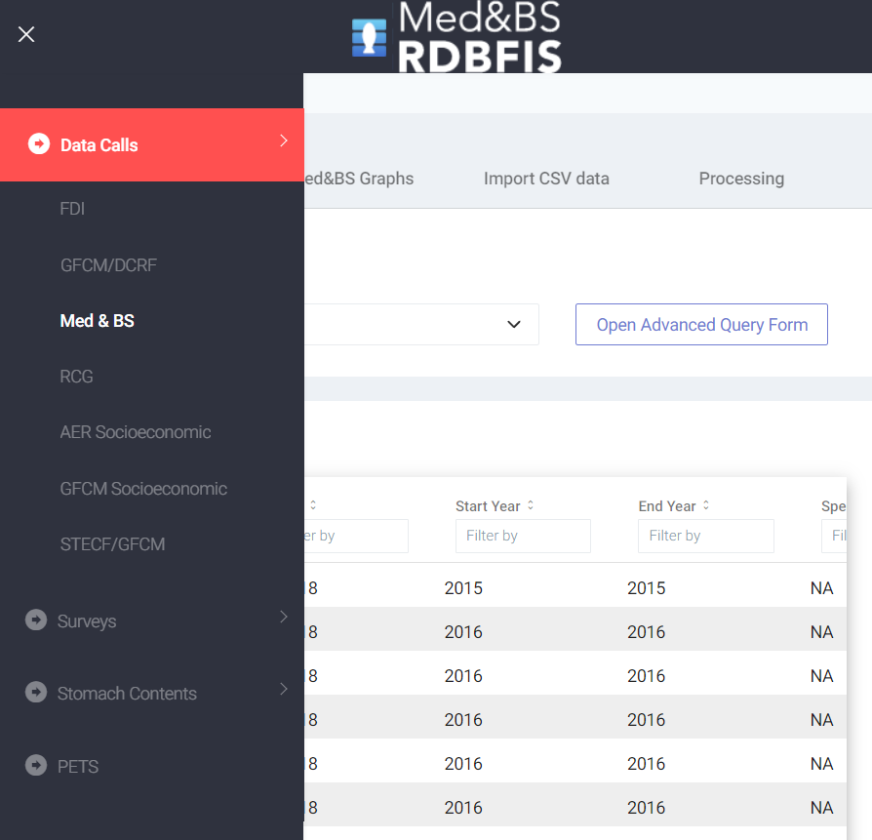

Slide 3
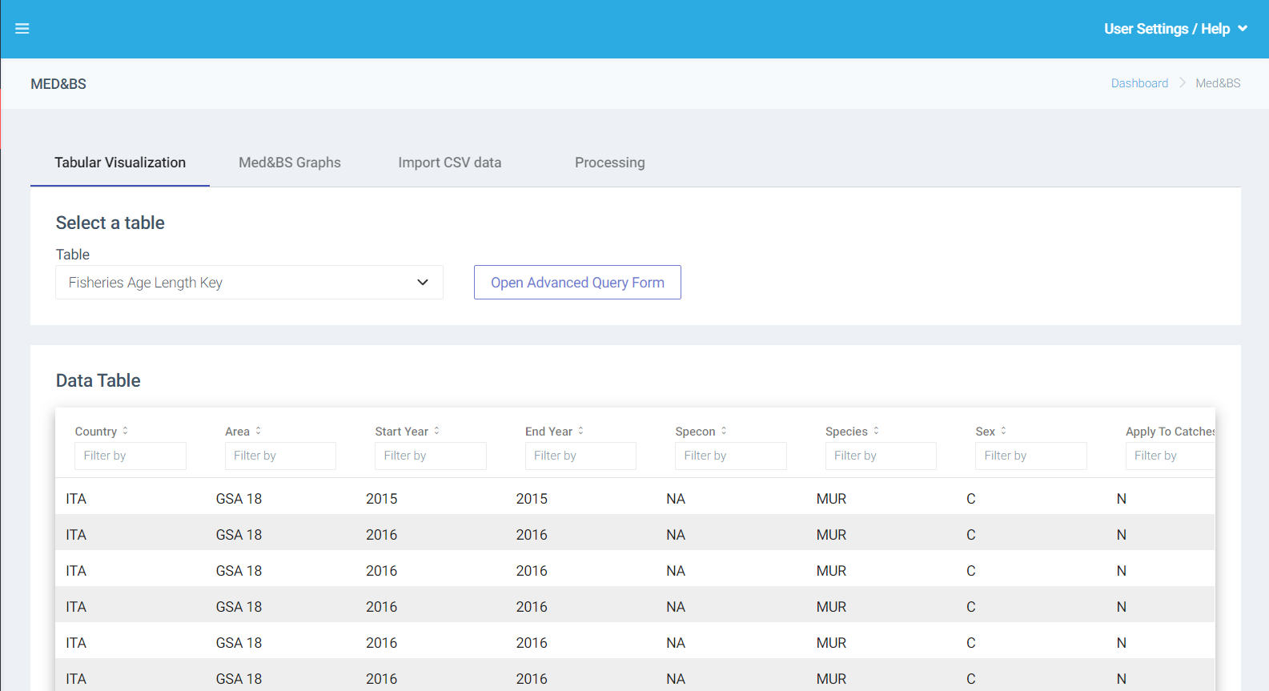
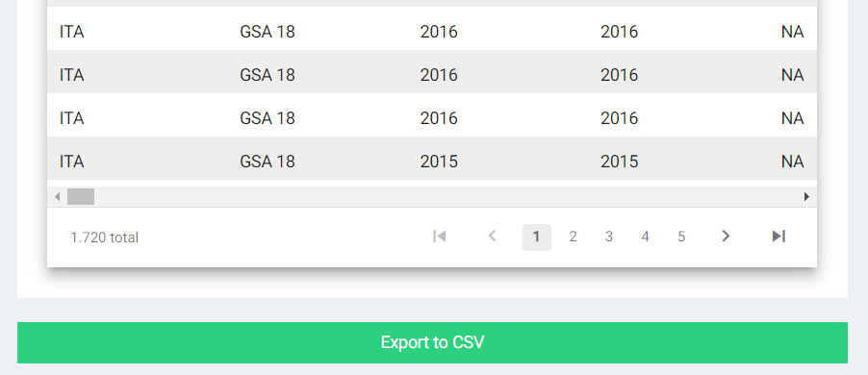
To download data with the expected structure for data import

Slide 4
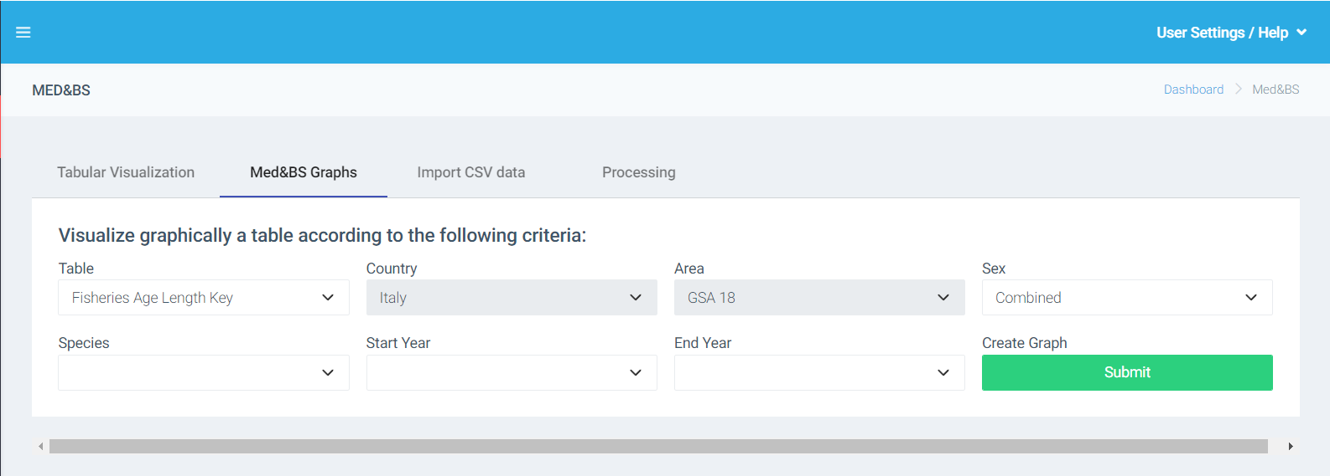

Slide 5
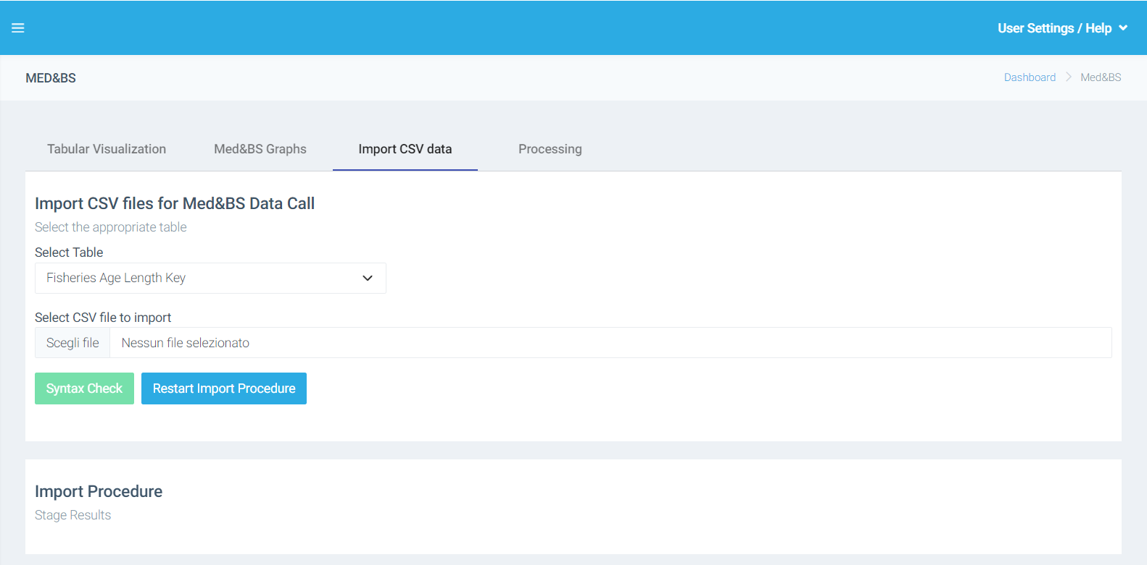

Slide 6
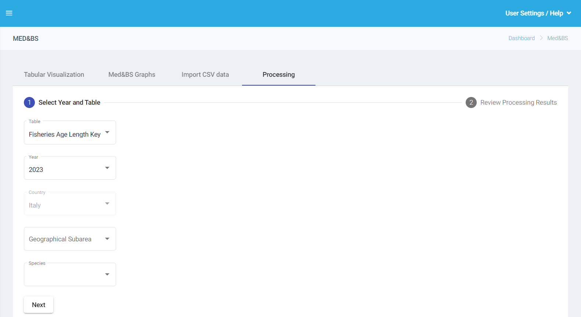

Slide 7
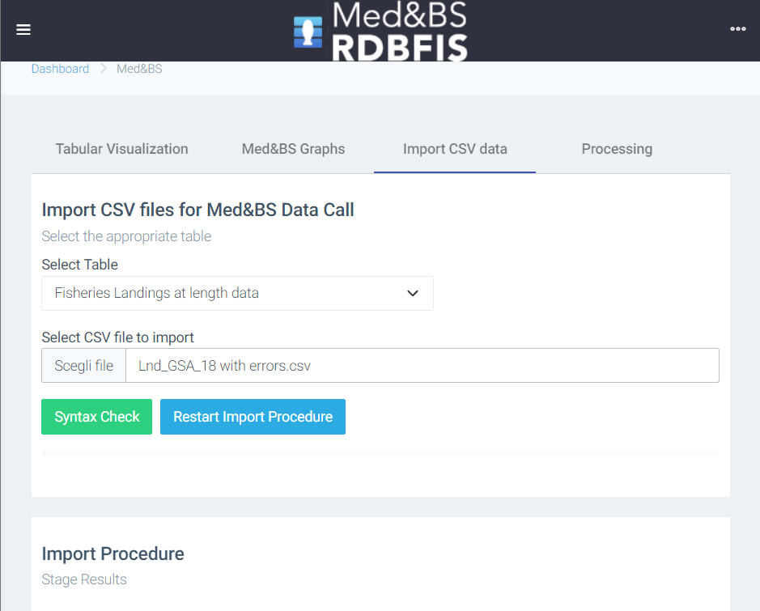
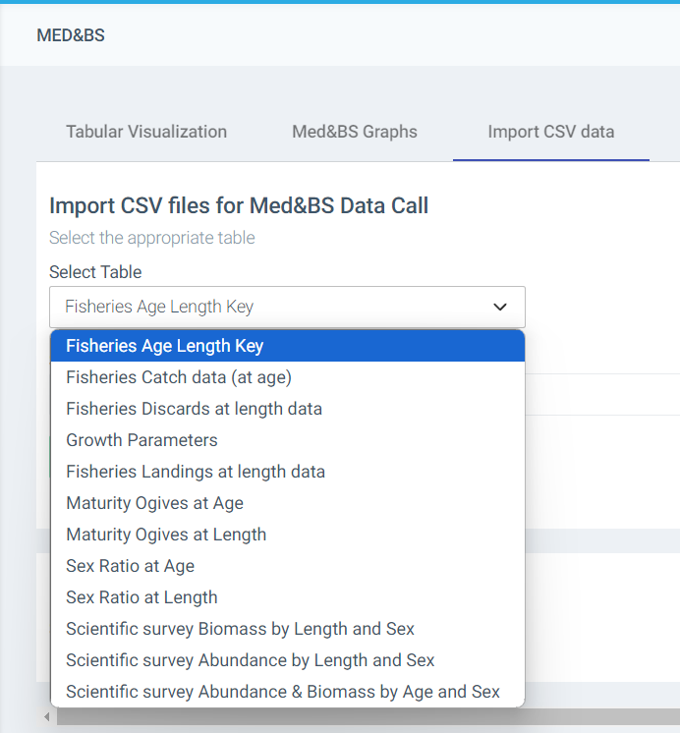

Data import
Data table not consistent with expected data
Error: Metadata header, cannot find the column headers - year, sex, cv, fishery, total_number_of_hard_structure_read_by_age, end_year, apply_to_catches_file, comments, mesh_size_range, vessel_length, quarter, age, gear, id, start_year, landings - .

Slide 8
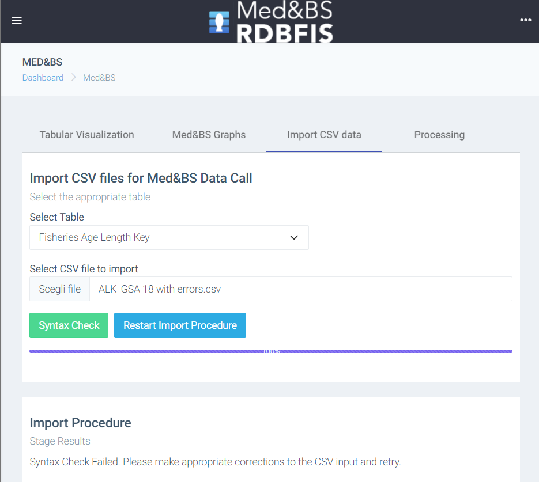
Syntax error
Error: any("F", "M", "C") fails for line: 40, column: sex, value: "R“
Error: unique( $country, $area, $start_year, $end_year, $specon, $species, $sex, $age ) fails for line: 46, column: age, value: "0" (original at line: 45)
Duplicated record

Slide 9
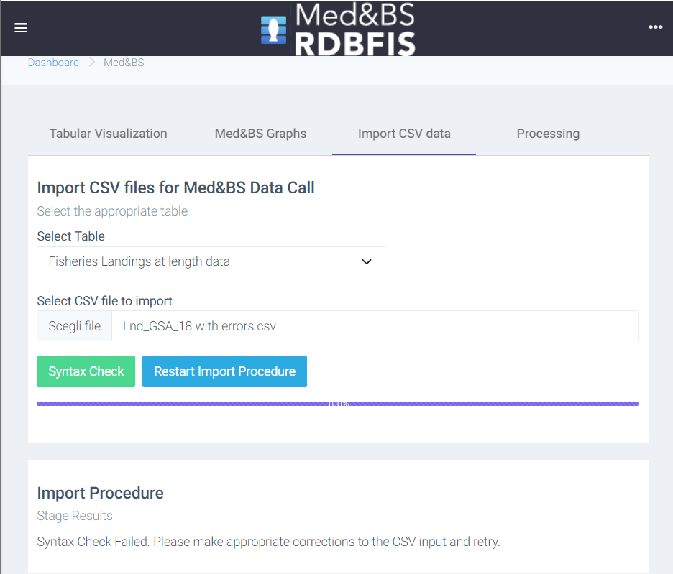
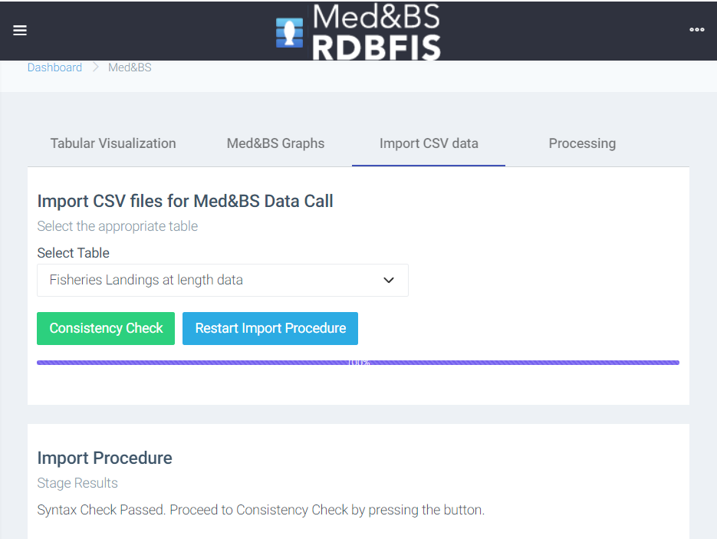
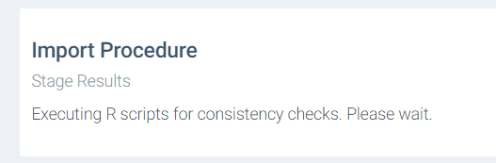
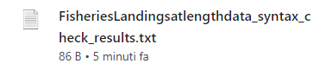

Slide 10
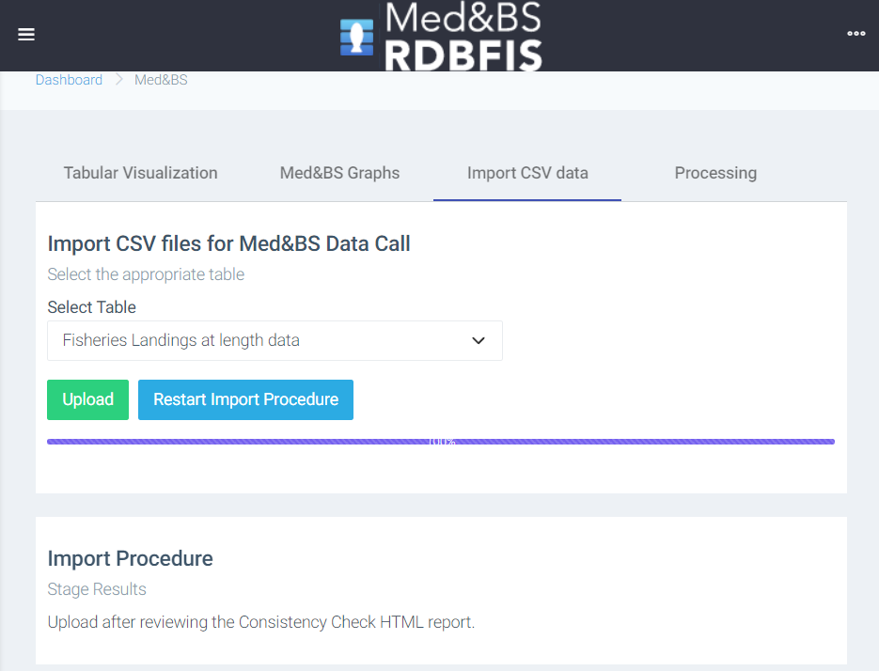
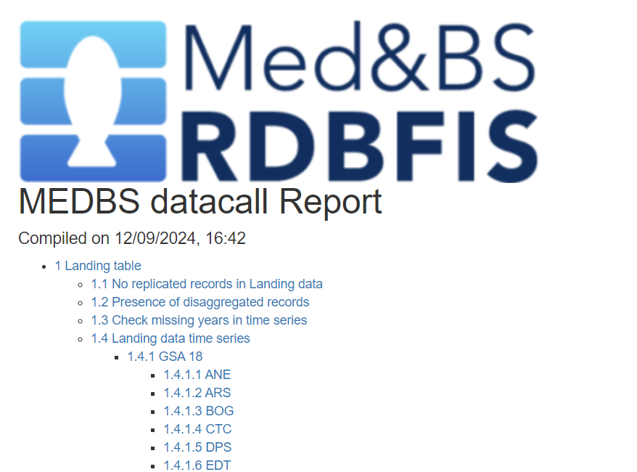


Slide 11
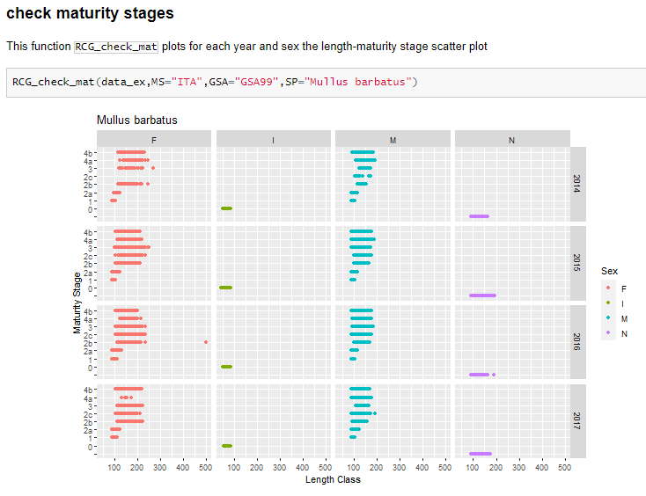



Structure of the RDBqc package
~ 109 functions included in the package
Dummy datasets included to run executable examples
Readme file and vignettes to support users in the use of functions included in the package
Functions’ documentation is embedded in the package
Updated version of the software is publically available can be downloaded from a GitHub repository
https://github.com/COISPA/RDBqc

Slide 12
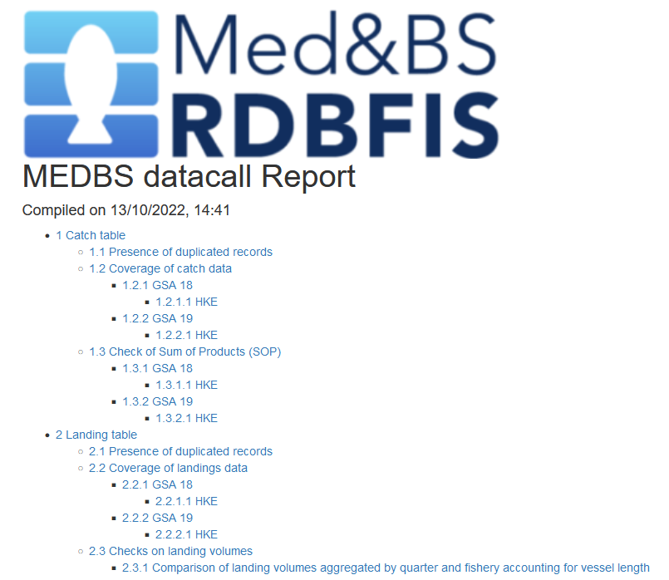

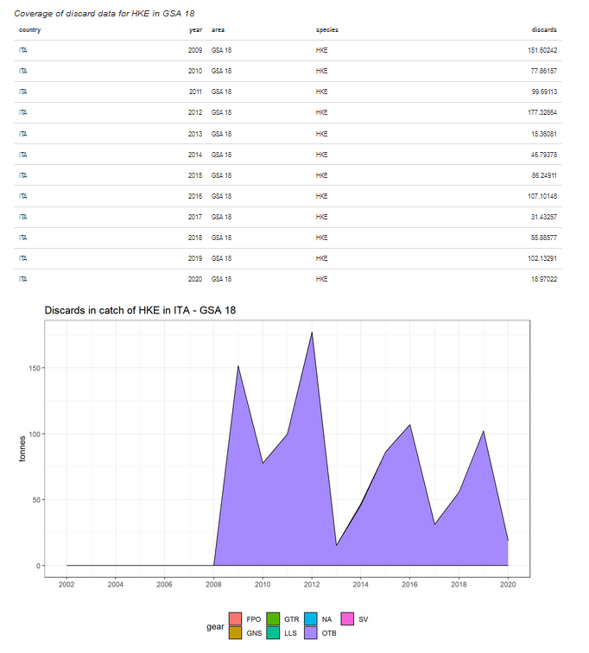
RDBqc functions were organized in a structured way in R Markdown documents to generate automatic reports
R Markdown files characteristics:
Are able to work:
on a single table
on a group of tables
creation of a table of contents with direct hyperlinks to reach the selected section of the report
automatic detection / user definition of the reference Member State, areas and species on which to perform the analysis
Use all QC functions included in the RDBqc R package, generating summary tables and plots useful to check data quality

Slide 13
Data validation and quality checking tools implemented in RDBqc
Supported data call formats:
Med&BS datacall (https://datacollection.jrc.ec.europa.eu/dc/medbs);
FDI datacall (https://datacollection.jrc.ec.europa.eu/dc/fdi );
GFCM DCRF data call (http://www.fao.org/gfcm/data/dcrf/platform/en/);
RCG (https://datacollection.jrc.ec.europa.eu/bg_BG/docs/rcg)
Cross-checks among data calls (developed in QualiTrain project)
For each table and data call:
Syntactic and conformity checks;
Data consistency quality checks.

Slide 14
RDBqc: data quality checks for Med&BS data call
Table | Check function | Table | Check function
Catch | MEDBS_check_duplicates | Discard | MEDBS_check_duplicates
Catch | MEDBS_Catch_coverage | Discard | MEDBS_comp_disc_YQ
Catch | MEDBS_SOP | Discard | MEDBS_comp_disc_YQ_fishery
Landing | MEDBS_check_duplicates | Discard | MEDBS_disc_mean_weight
Landing | MEDBS_Landing_coverage | Discard | MEDBS_ks
Landing | MEDBS_comp_land_Q_VL_fishery | Discard | MEDBS_length_ind
Landing | MEDBS_comp_land_YQ_fishery | Discard | MEDBS_lengthclass_0
Landing | MEDBS_ks | Discard | MEDBS_plot_disc_vol
Landing | MEDBS_lengthclass_0 | Discard | MEDBS_plot_discard_ts
Landing | MEDBS_length_ind | Discard | MEDBS_weight_0
Landing | MEDBS_yr_missing_length | Discard | MEDBS_weight_minus1
Landing | MEDBS_weight_0 | Discard | MEDBS_yr_missing_length
Landing | MEDBS_weight_minus1 | GP | MEDBS_GP_check
Landing | MEDBS_land_mean_weight | GP | MEDBS_LW_check
Landing | MEDBS_plot_land_vol | MA | MEDBS_MA_check
Landing | MEDBS_plot_landing_ts | ML | MEDBS_ML_check
Landing | MEDBS_comp_land_Q_VL | SRA | MEDBS_SA_check
Landing | MEDBS_comp_land_YQ | SRL | MEDBS_SL_check
Discard | MEDBS_Discard_coverage | ALK | MEDBS_ALK
STREAM and STECF EWG 21-02 and 22-03 included

Slide 15
RDBqc: data quality checks for FDI format data call
Functions for FDI (Fishery Dependent Information) data call tables relevant for Mediterranean and Black Sea (specifically A, G, H, I and J tables) aim at verifying :
the consistency of transversal variables (effort and landing);
the spatial coverage;
temporal coverage.
Cross-checks among the tables have been also implemented in the RDBqc R package, following the checks described in the STECF EWG 21-12 report.
Table | Check functions | Table | Check functions
Table A | FDI_Check_empty_field_A | Table I | FDI_Check_empty_field_I
Table A | FDI_Check_record_duplicated_A | Table I | FDI_Check_record_duplicated_I
Table A | FDI_coverage | Table I | FDI_coverage
Table A | FDI_cov_tableA | Table I | FDI_checks_spatial_HI
Table A | FDI_disc_coverage | Table I | FDI_check_coord
Table A | FDI_prices_not_null | Table J | FDI_Check_empty_field_J
Table A | FDI_price_cov | Table J | FDI_Check_record_duplicated_J
Table G | FDI_Check_empty_field_G | Table J | FDI_coverage
Table G | FDI_Check_record_duplicated_G | Table J | FDI_cov_tableJ
Table G | FDI_coverage | Table J | FDI_vessel_lenth
Table G | FDI_cov_tableG | Cross checks | FDI_fishdays_cov
Table H | FDI_Check_empty_field_H | Cross checks | FDI_landweight_cov
Table H | FDI_Check_record_duplicated_H | Cross checks | FDI_vessel_numbers
Table H | FDI_coverage | Cross checks | FDI_Cross_checks_AG
Table H | FDI_checks_spatial_HI | Cross checks | FDI_Cross_Checks_AH
Table H | FDI_check_coord | Cross checks | FDI_Cross_Checks_IG

